Slide 1
Mahindra Group- Corporate AV
Mahindra Rise - Corporate AV.mp4

Slide 5

Our journey began in 1945, when 2 enterprising brothers set up a Steel Trading firm....
Notes:
5

Slide 12


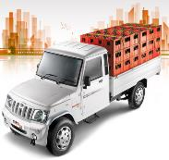
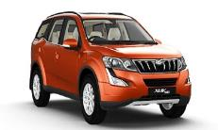

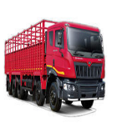
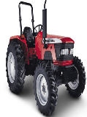
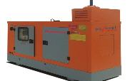
Utility Vehicle
Personal Vehicle
Construction Equipment
Trucks & Buses
Diesel Generators
Tractors
Footprints in Nepal…

Slide 13
Mahindra Powerol

Slide 14
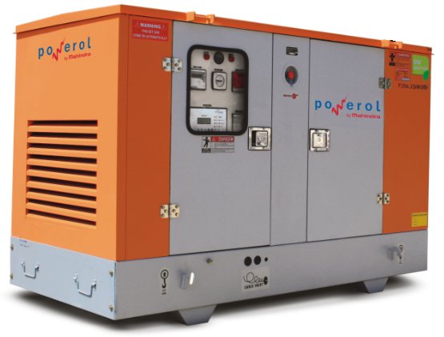
Mahindra Powerol
One of the fastest growing business in Mahindra Group
Leader in telecom segment with 61% M.S* in India
Present with 70+ exclusive showrooms across India
More than 1.5 lakh diesel generators across varied segments
Present in 26 countries across the globe
Winner of Deming Prize 2014, Japan

Slide 15





























Patrons of Mahindra Powerol across the globe

Slide 16





Performance Awards
Prestigious Information Week-Edge Award
for deployment of technology for creating maximum business impact
Consumer & Industry Survey: World Consulting & Research Corporation
Most Valuable Brand 2014
CMO Council
Master Brand Award 2012
Indian Council for Market Research (ICMR).
Power Brands 2010-2011
Deming Prize given by J.U.S.E
Amongst 3 companies only in the world to be awarded in 2014

Slide 17

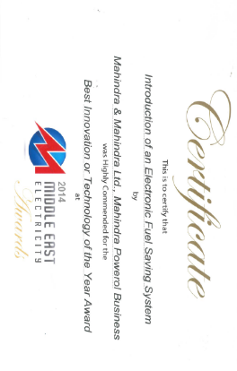
Performance Awards
Indus Towers: World’s largest independent tower co
‘Partner of the Year’ platinum award (2013)
Platinum, Gold & Silver Awards for outstanding performance in various categories.(2014)
Quality Excellence (Infra Equipment Category) 2011
Best Delivery Performance (SME Category for delivering best uptime) 2011
Performance Awards- 2011, 2012, 2013
Frost & Sullivan’s Voice of Customer Award
Most preferred brand in Telecom Cell Site Segment (2011-12, 2013-14)
Best Bang for the Buck Category (2001-12)
Customer Value Enhancement Category (2014)
Middle East Electricity Exhibition, Dubai
‘Best Innovation or Technology of the Year’ award 2014
Nominated to top 3 position in Innovation and Technology category 2013

Slide 18
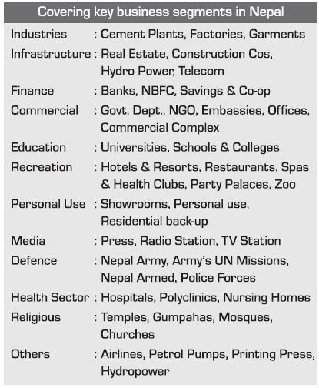
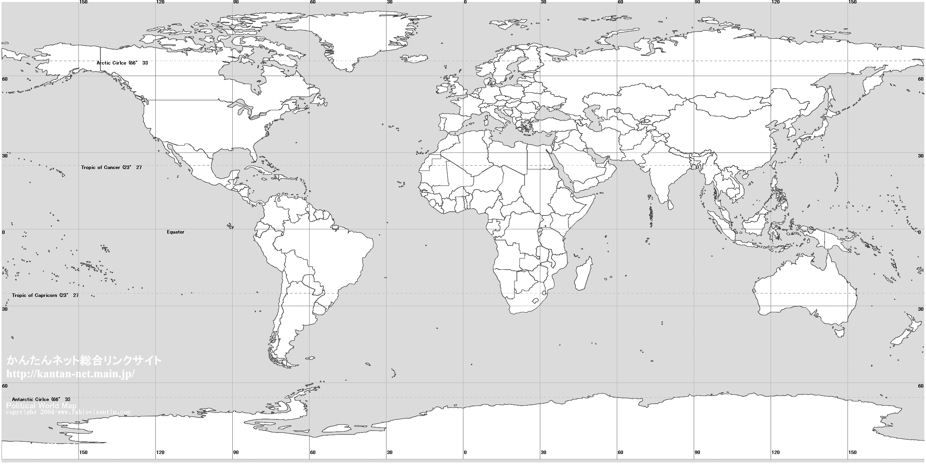


Mahindra Powerol
Mahindra Powerol in Nepal
Product range from 7.5kVA-200kVA
No.2 diesel generator player
Strong foothold in institutional segment (Banks/Defence) with growing presence in retail segment
National Distributor: Agni Energy
Exclusive showrooms of Agni Energy and 10+ dealers across the nation

Slide 19
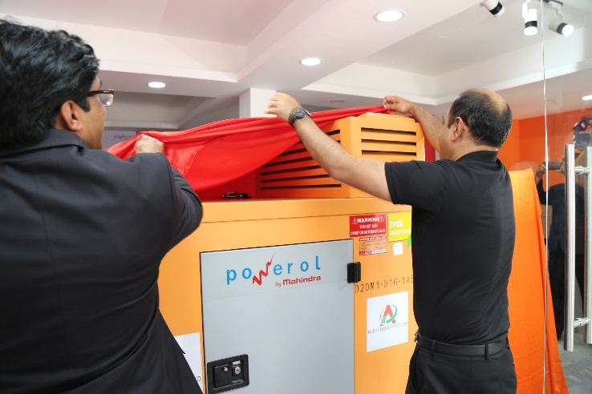
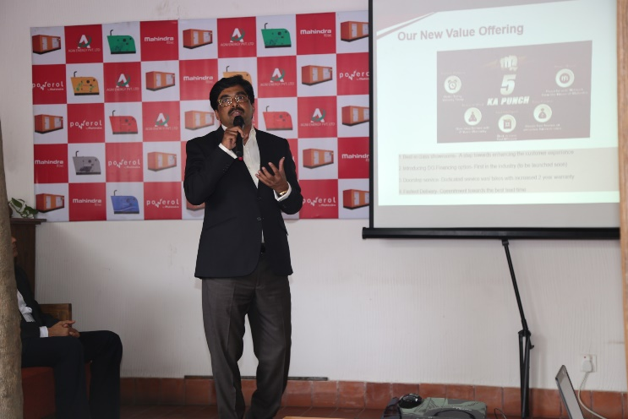
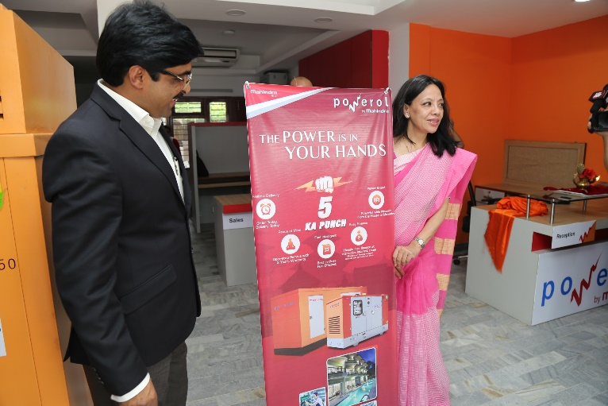
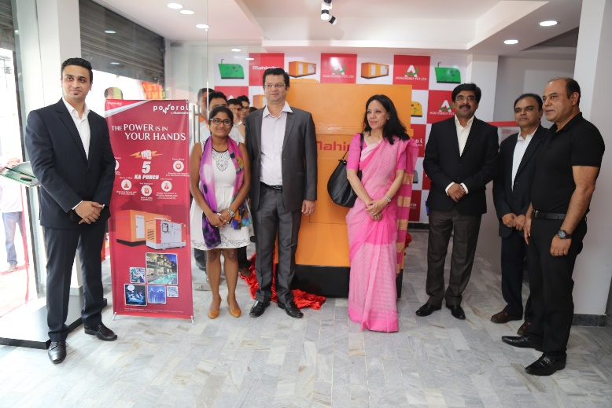
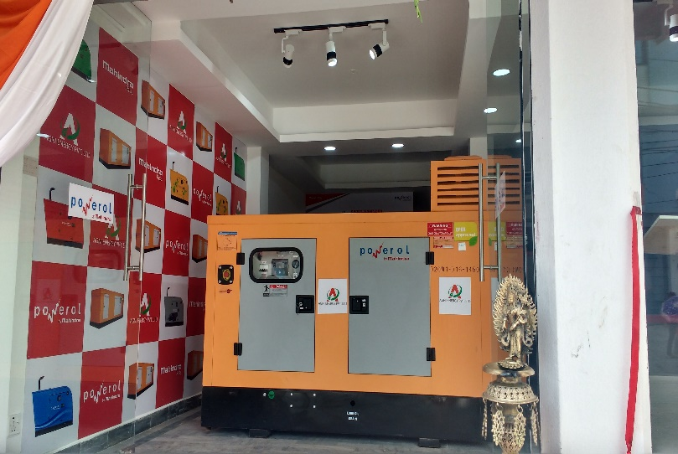
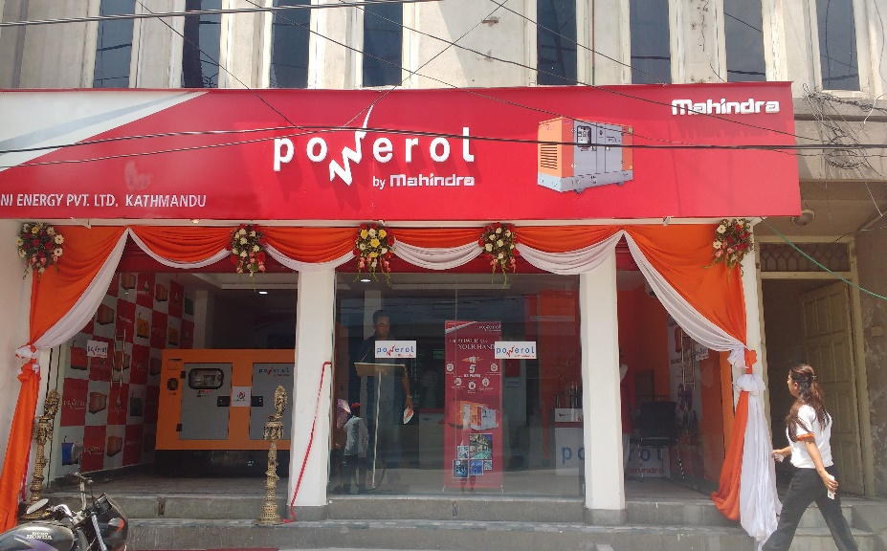
Agni Energy showroom in Kathmandu
Best in class showroom with improved customer experience & SSS support

Slide 20
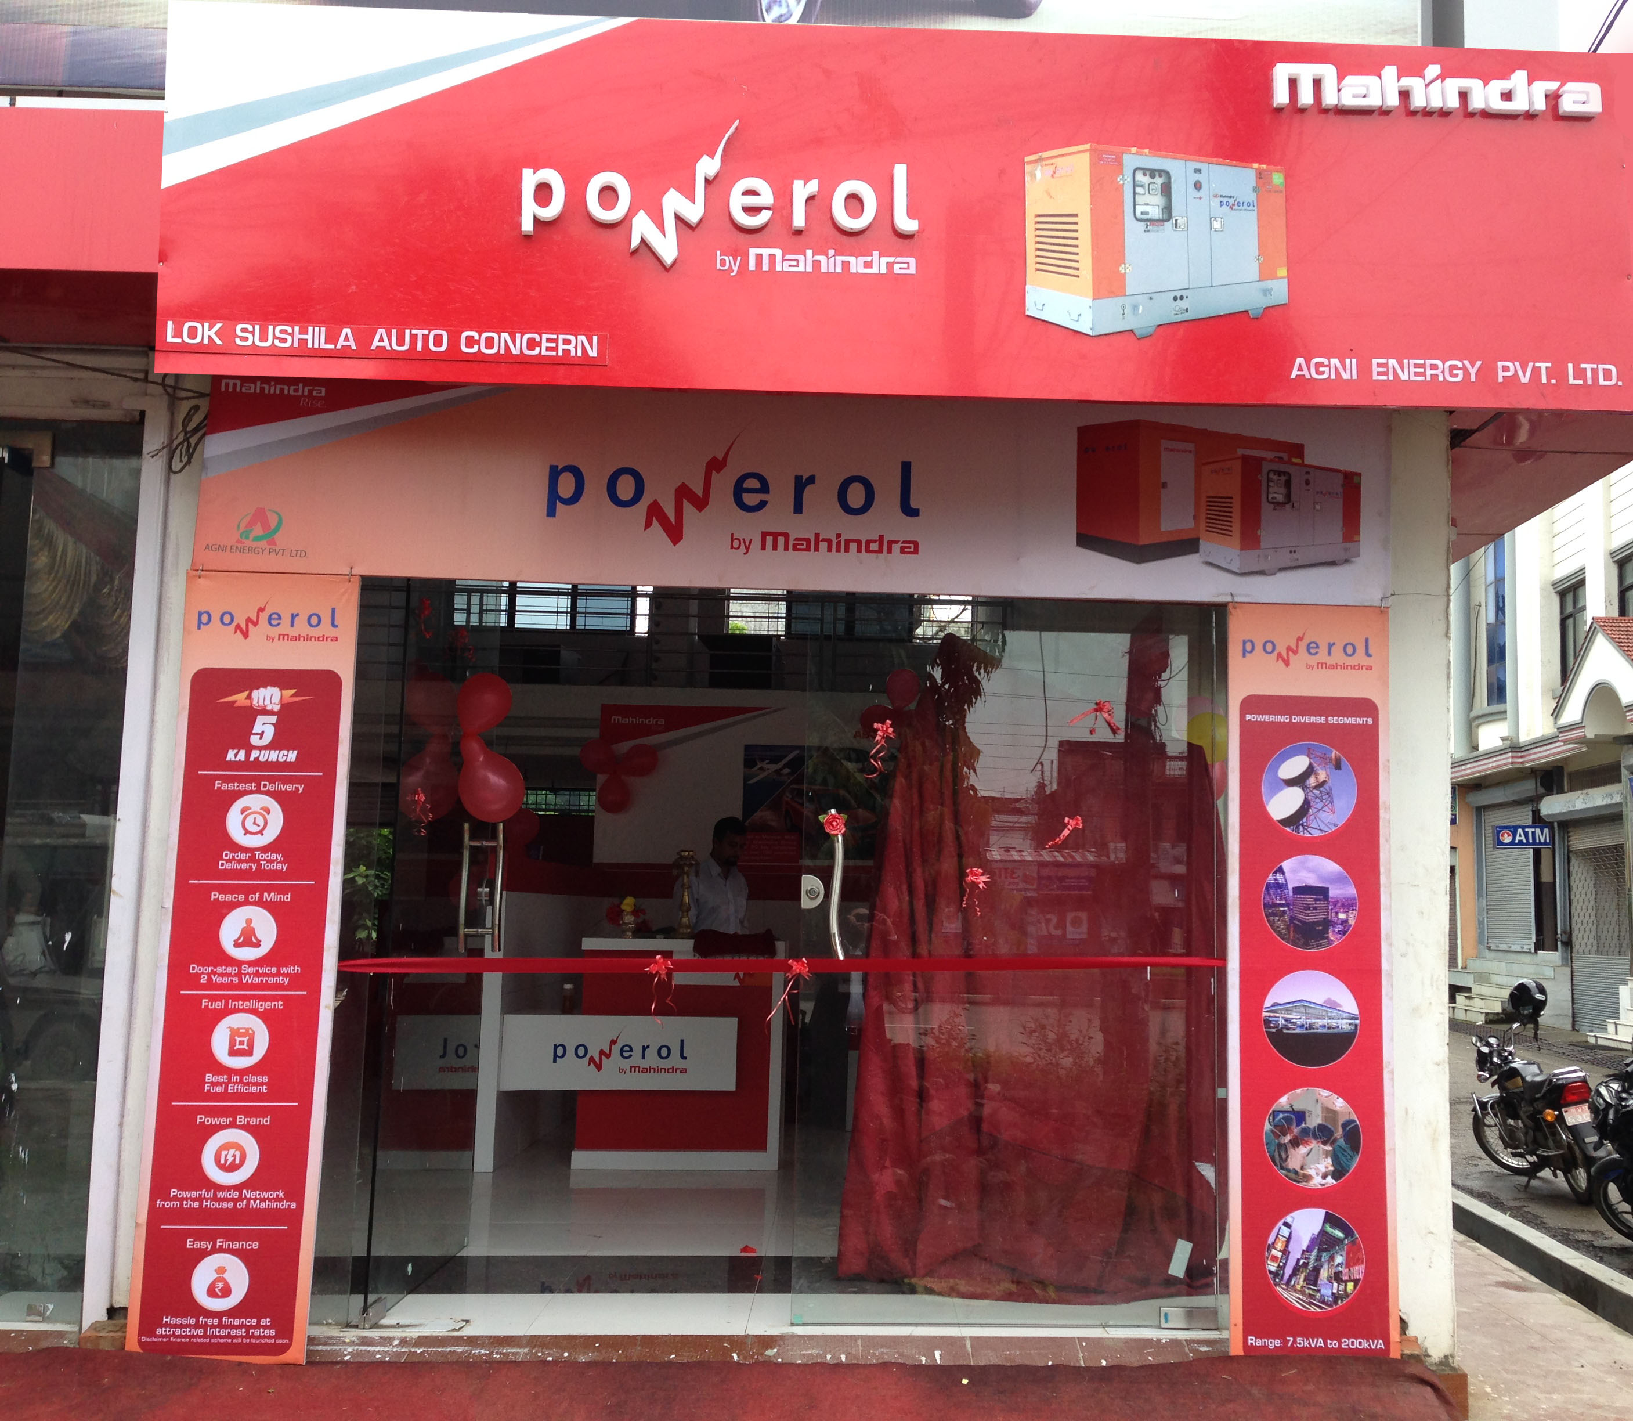
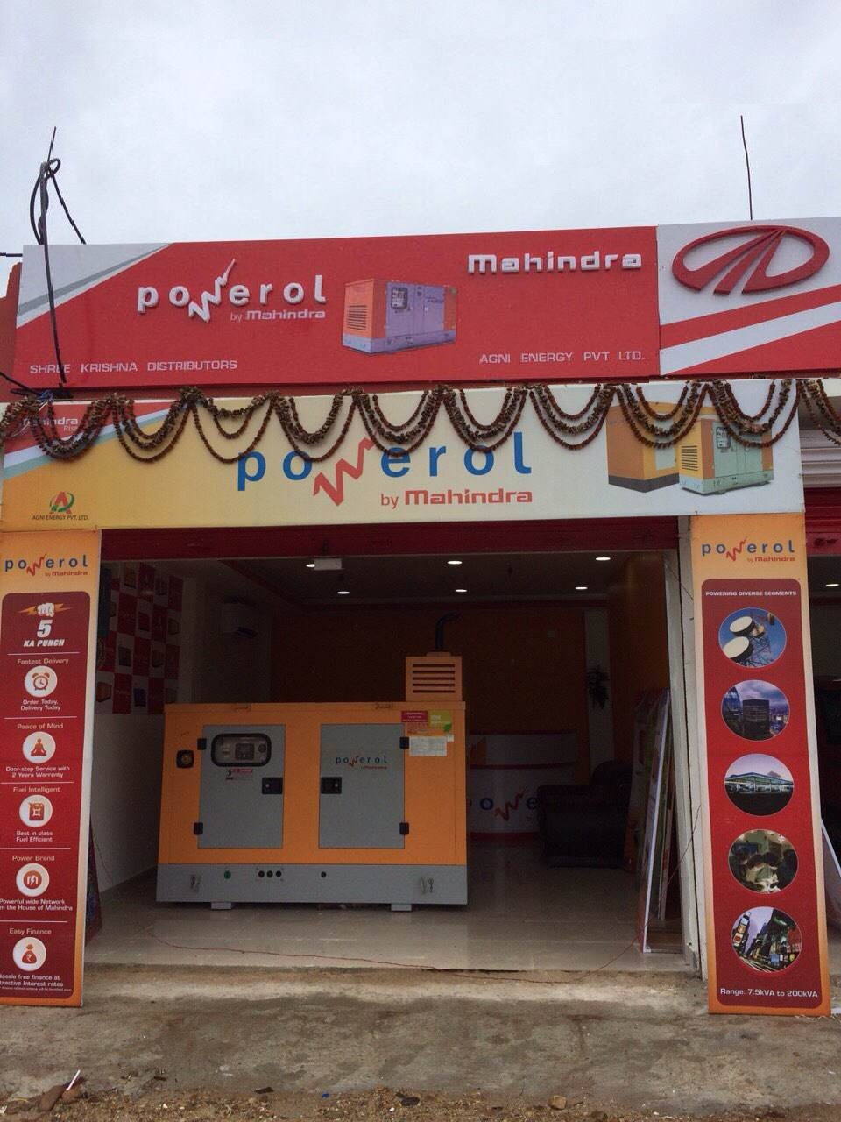
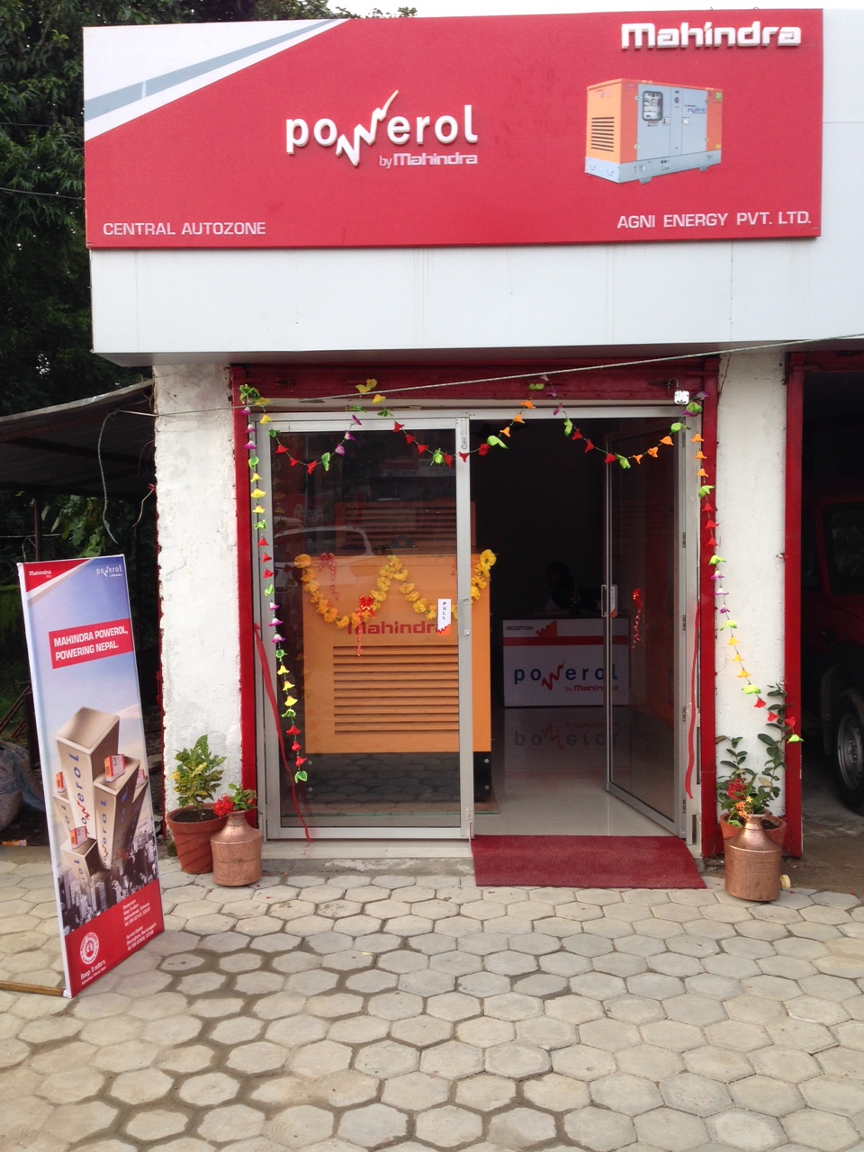
Dealer showrooms under Agni Energy
Butwal
Janakpur
Narayanghat

Slide 21
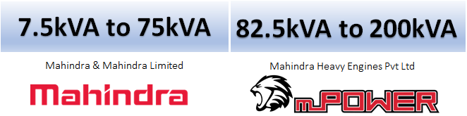



Product Configurations
Engine
Alternator
Controller

Slide 22


Mahindra Powerol- Designed for customer requirements
Functionality
Maintenance Delight
Reliability
Customer Expectations
Ease of Use
Aesthetics
Peace of Mind
Operator Safety
What Globally Customers look out for

Slide 23
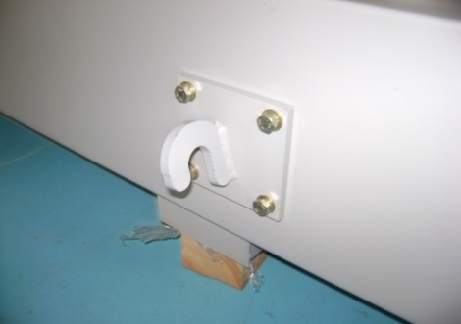
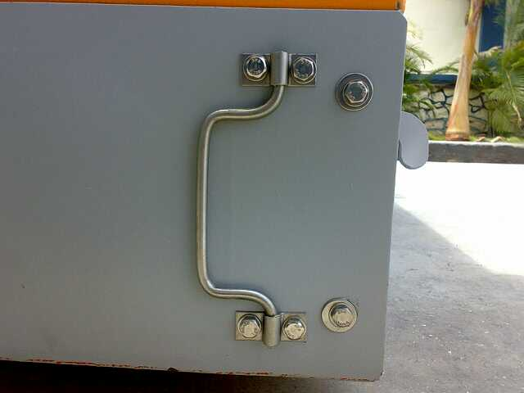
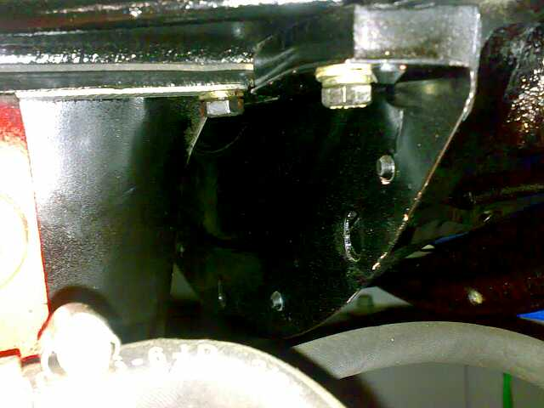
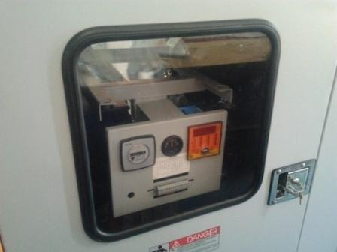
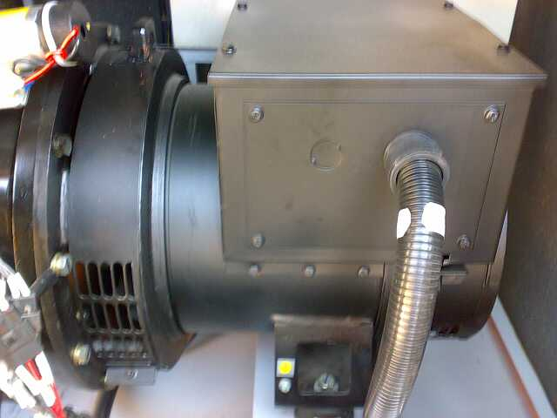
Mahindra Powerol- Designed for customer requirements
Detachable lifting hooks → saves saving while transporting
Removable diesel tank → ensures faster dismantling for difficult sites and also ease of cleaning
Provision of Guard to avoid dust & water entry in self starter and Flywheel housing
Functionality
Rubber Beading with improved Ozone Resistance→ No cracking at ambient temperature of 55°C
Powder coating over alternator body → better corrosion resistance

Slide 24
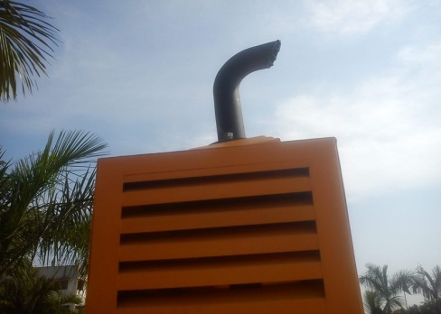
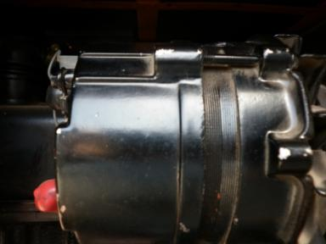
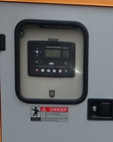
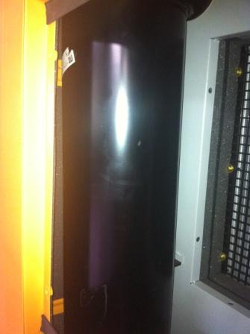
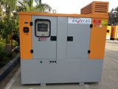
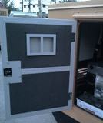
Mahindra Powerol- Designed for customer requirements
Big size of glass window for easy viewing of DG parameters in Deep sea controller.
Shorter exhaust tail pipe- Less space requirement
Painting over charging alternator- prevents oxidation.
Aesthetics
Application of Heat Resistant black color paint with good adhesion
Dual tone Canopy color giving a pleasing look & ease of identification
Customized pockets in canopy doors for storing of Operation & Maintenance Manuals

Slide 25
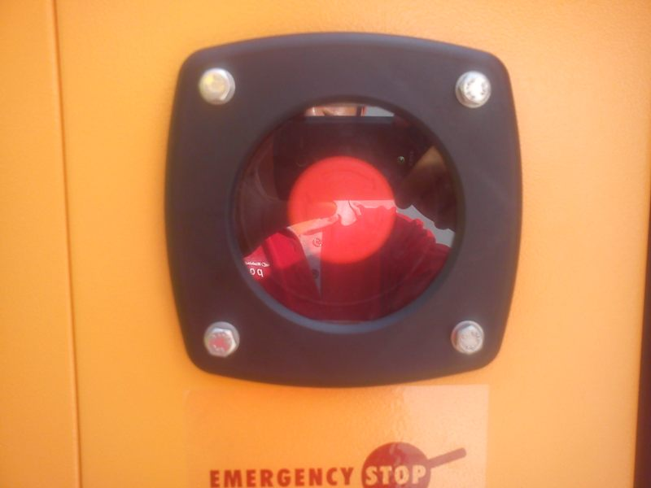
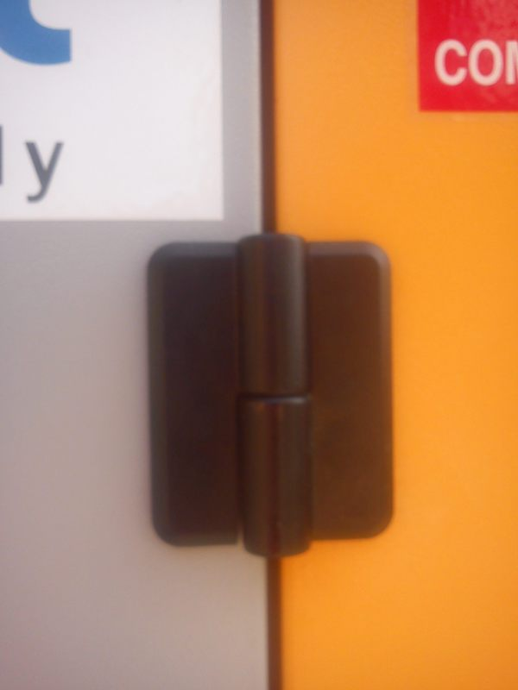
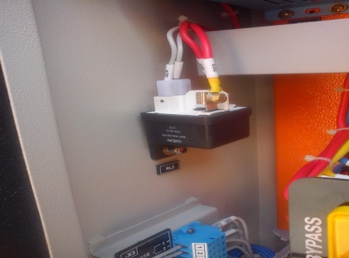
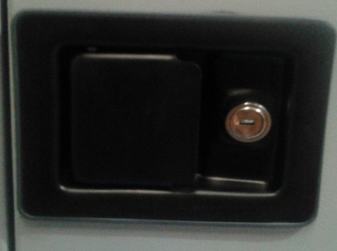

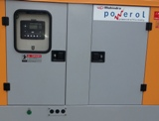
Mahindra Powerol- Designed for customer requirements
Tamper-proof cast iron door hinges
OEN relay located inside the panel- Prevents tampering as connections are not exposed
Tamper-proof emergency stop switch cover
Peace of Mind
Tamper-proof & enhanced powder coated door locks
Silent DG sets (less than 75dBA @ 1 mtr
Avoid theft of battery & diesel through lockable doors→ unique set of keys for each DG set

Slide 26
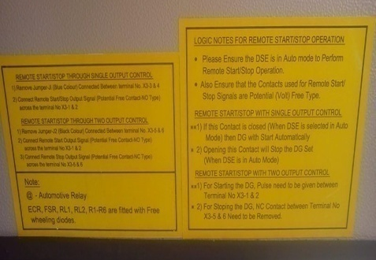
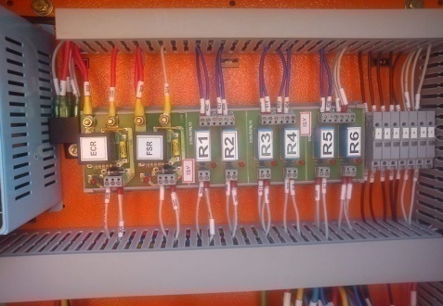
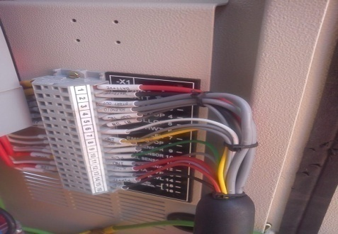
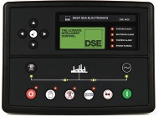
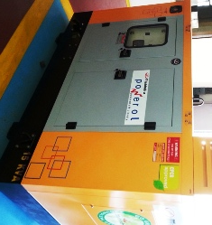
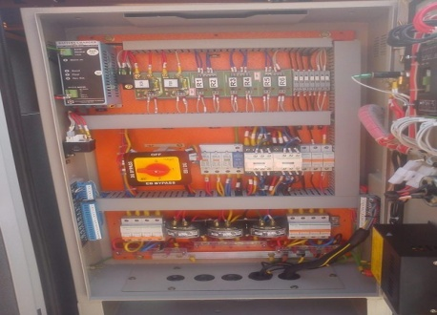
Mahindra Powerol- Designed for customer requirements
Instruction decals for connecting for remote start/stop- User-friendly instructions
Ease in identification & Ease in serviceability, if required- high level of customization
User-friendly nameplates for connection guidelines
Ease of Use
Easy to use Deep Sea Electronics- DSE Controller
Lifting hooks facilitating ease in transportation of DG
Dedicated terminal blocks→ ease of connectivity for remote start / stop

Slide 27
Why Mahindra Powerol in Nepal?
Best in class fuel efficiency
Strong after sales support
Lowest noise level
Easily available spare parts
Low maintenance & cost of ownership
Ideal for rooftop installations

Slide 28
Why Mahindra Powerol in Nepal?
Best in class fuel efficiency
Strong after sales support
15-20%* lower than main competition across the range
10 dealers under Agni Energy + 50+ dealers under Agni Group
Low cost of ownership
Easily available spare parts
Savings of NPR 6.5L* for a period of 5 years (Reference rating: 20kVA)
Commonality with Mahindra tractors up to 75kVA & trucks from 82.5kVA onwards
Lowest noise level
Ideal for rooftop installations*
Talk comfortably on your mobile at distance of 1m
Running successfully across many institutions in Nepal
* Terms & conditions applied

Slide 29
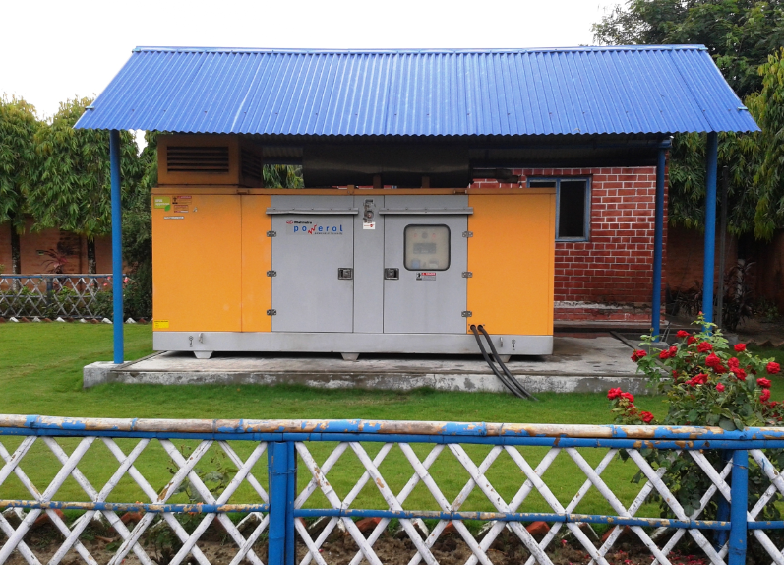
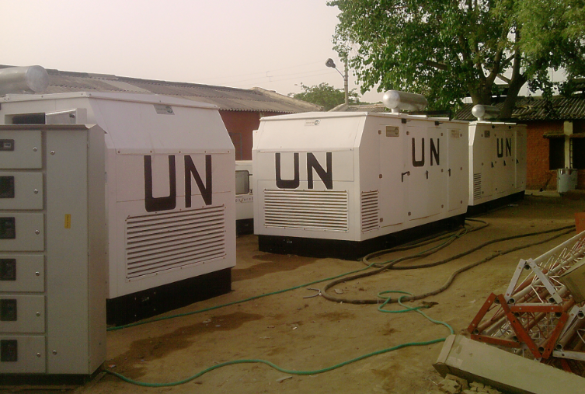
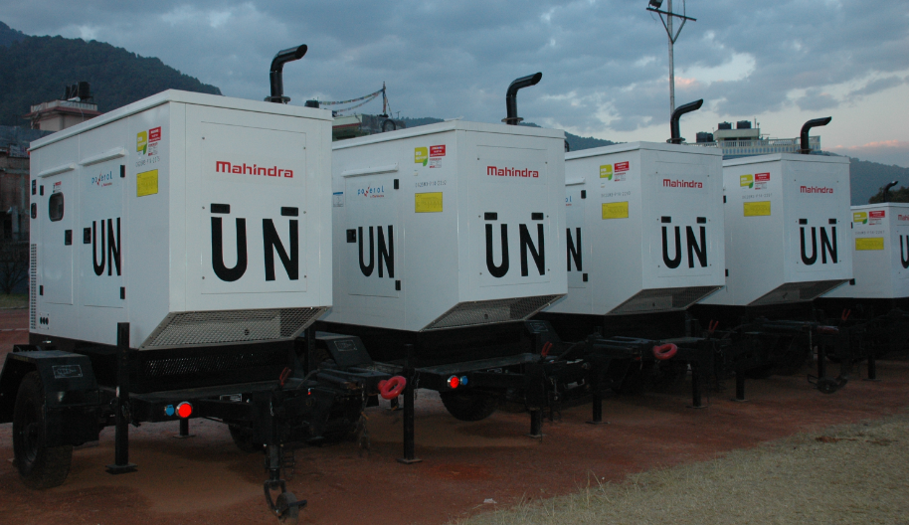
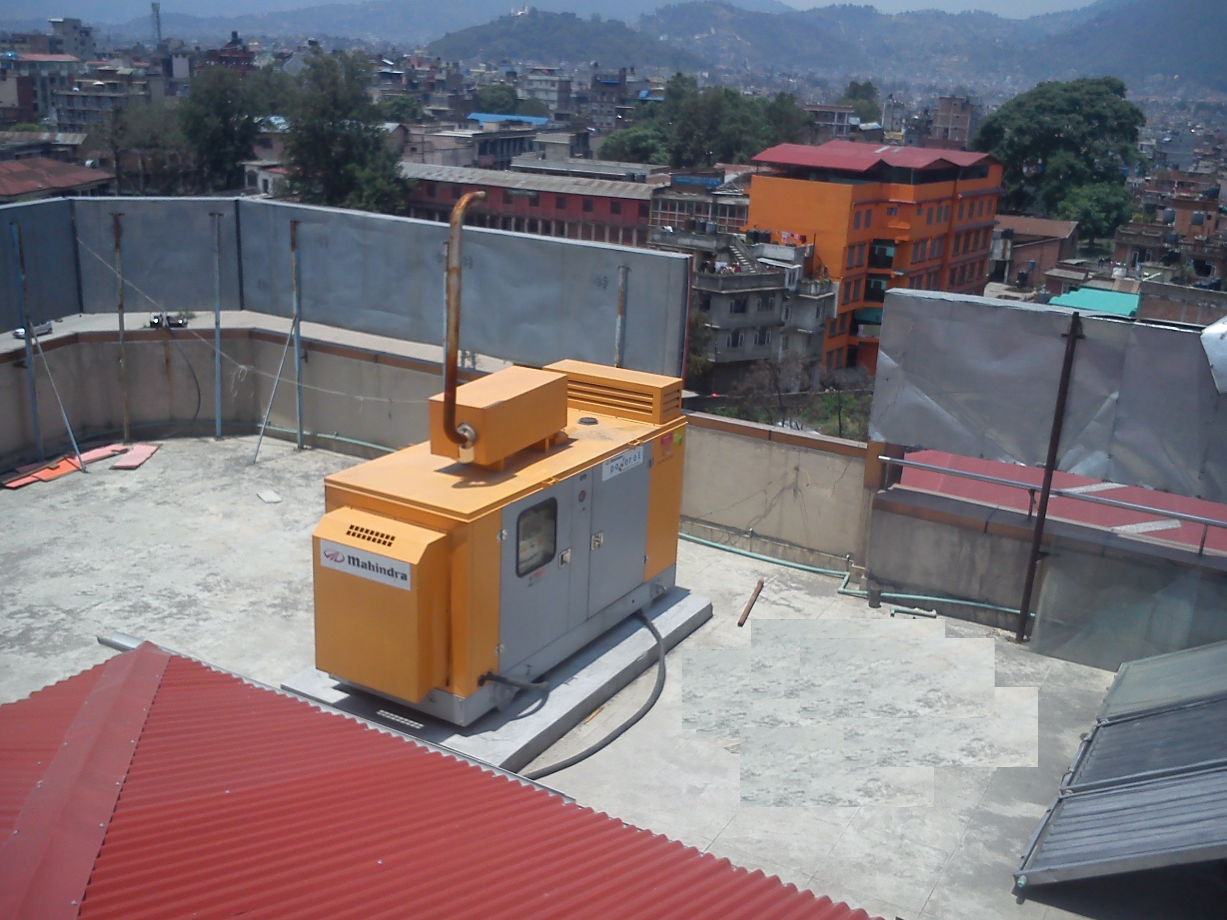
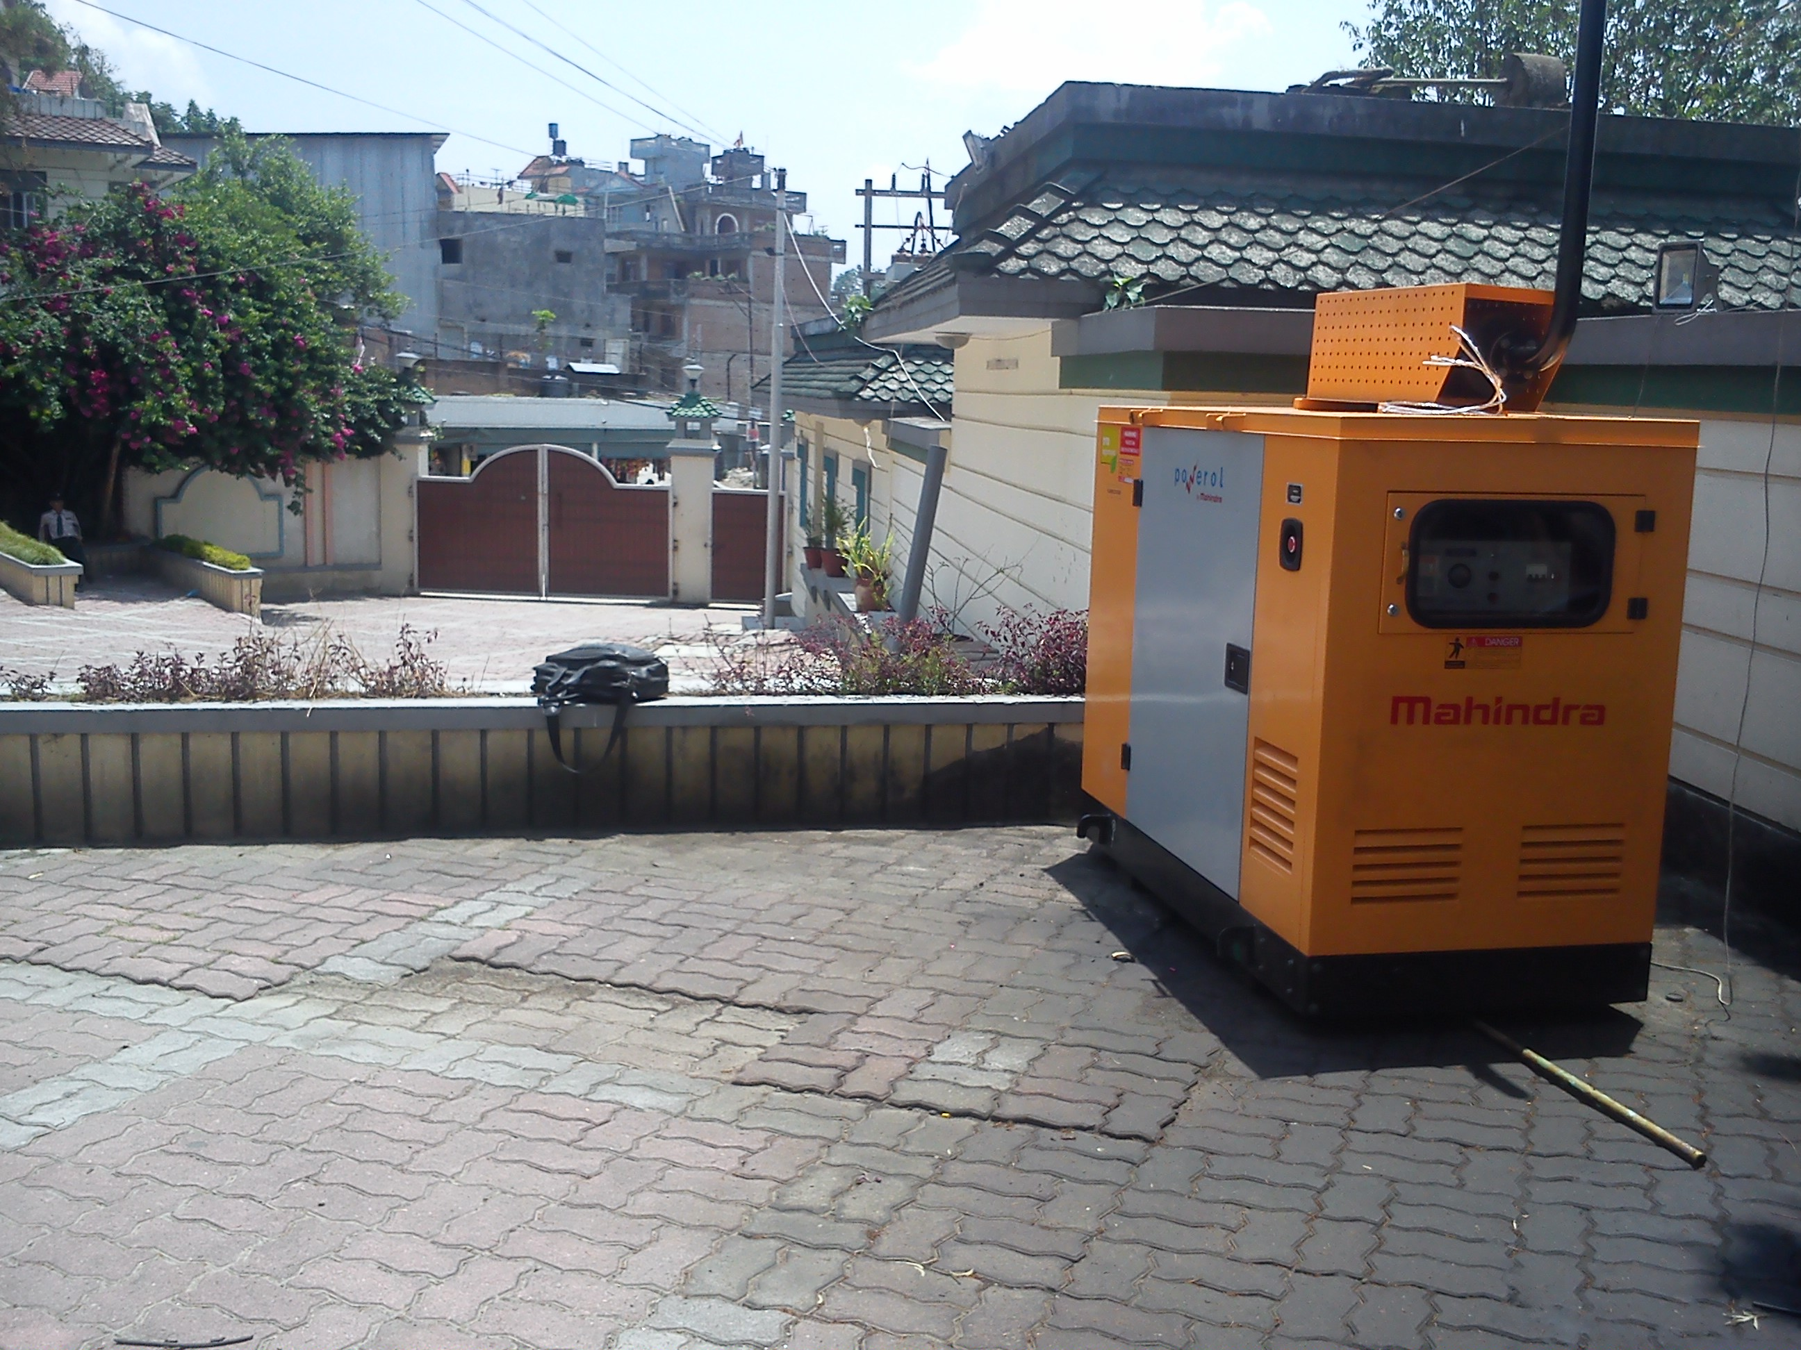
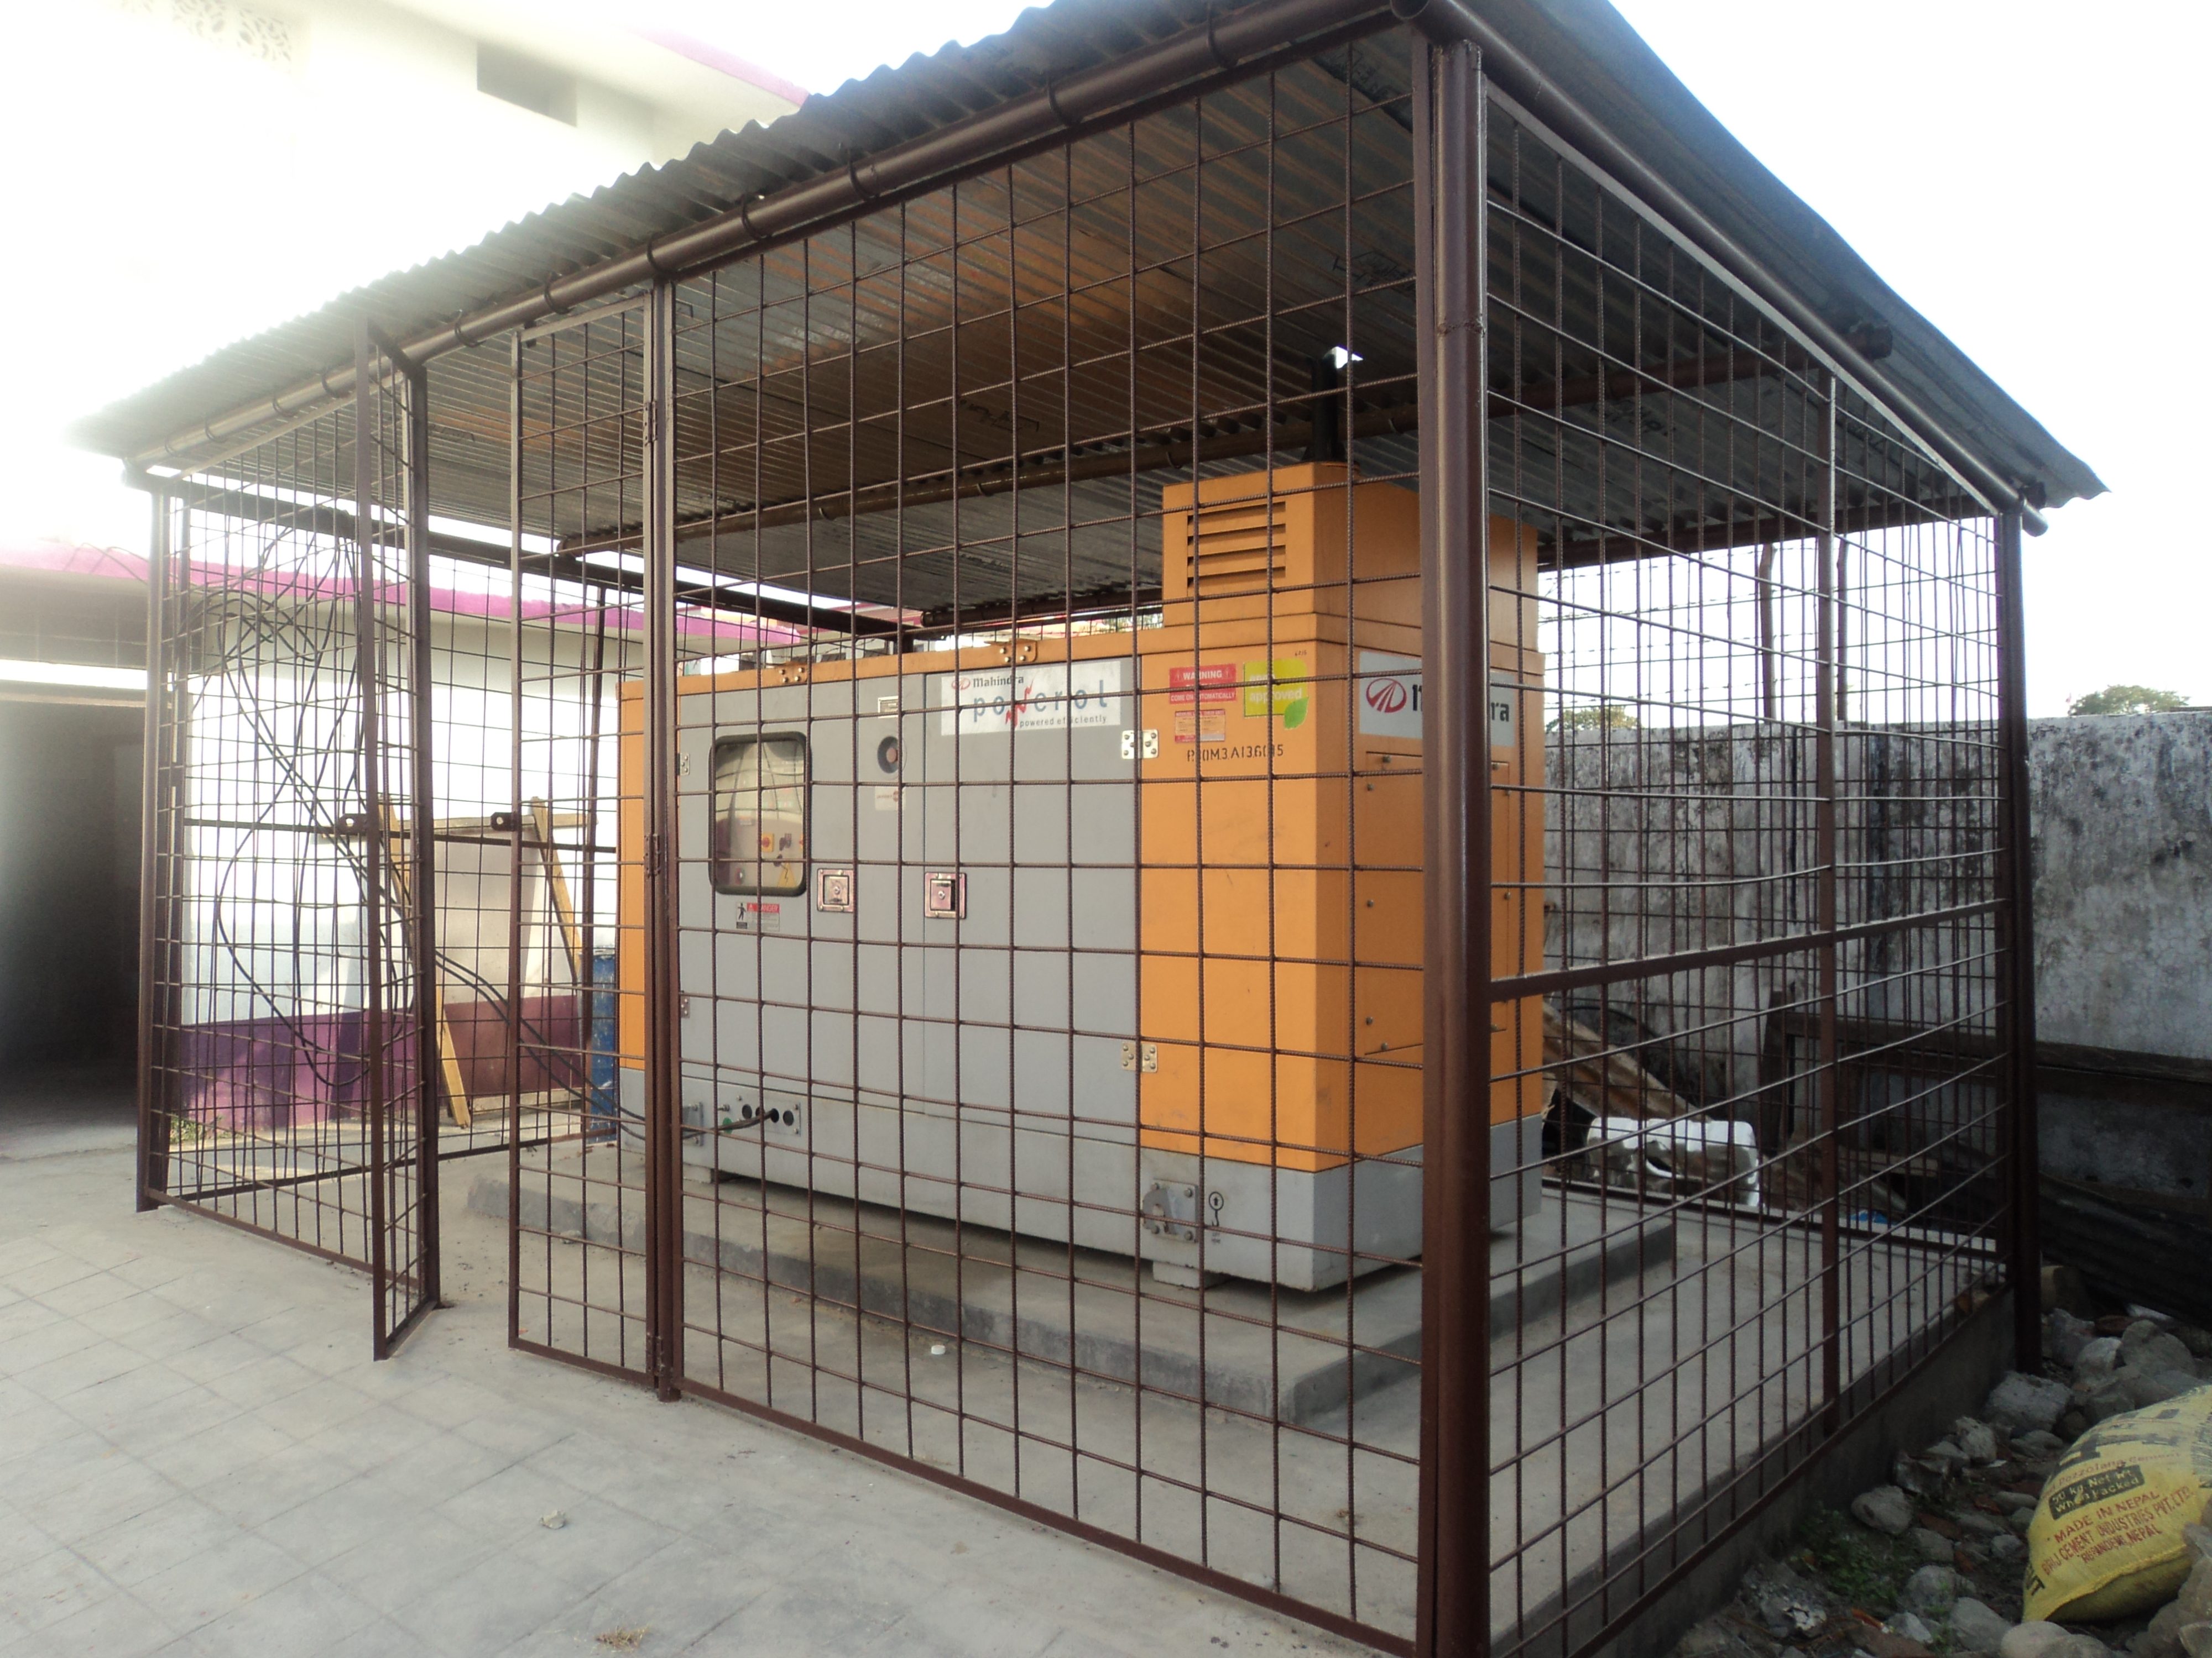
Reference Installations across segments
UNICEF BIRATNAGAR
1 X 100kVA
NEPAL APF PROJECT FOR SOUTH SUDAN
6 X 140kVA, 5 X 62.5kVA (Trolley), 5 X 40kVA (Trolley)
PRABHU BIKASH BANK (ROOFTOP)
1 X 62.5kVA
EMBASSY IN KATHMANDU
1 X 20kVA
ELITE COLLEGE NEPALGUNJ
1 X 40kVA

Slide 30
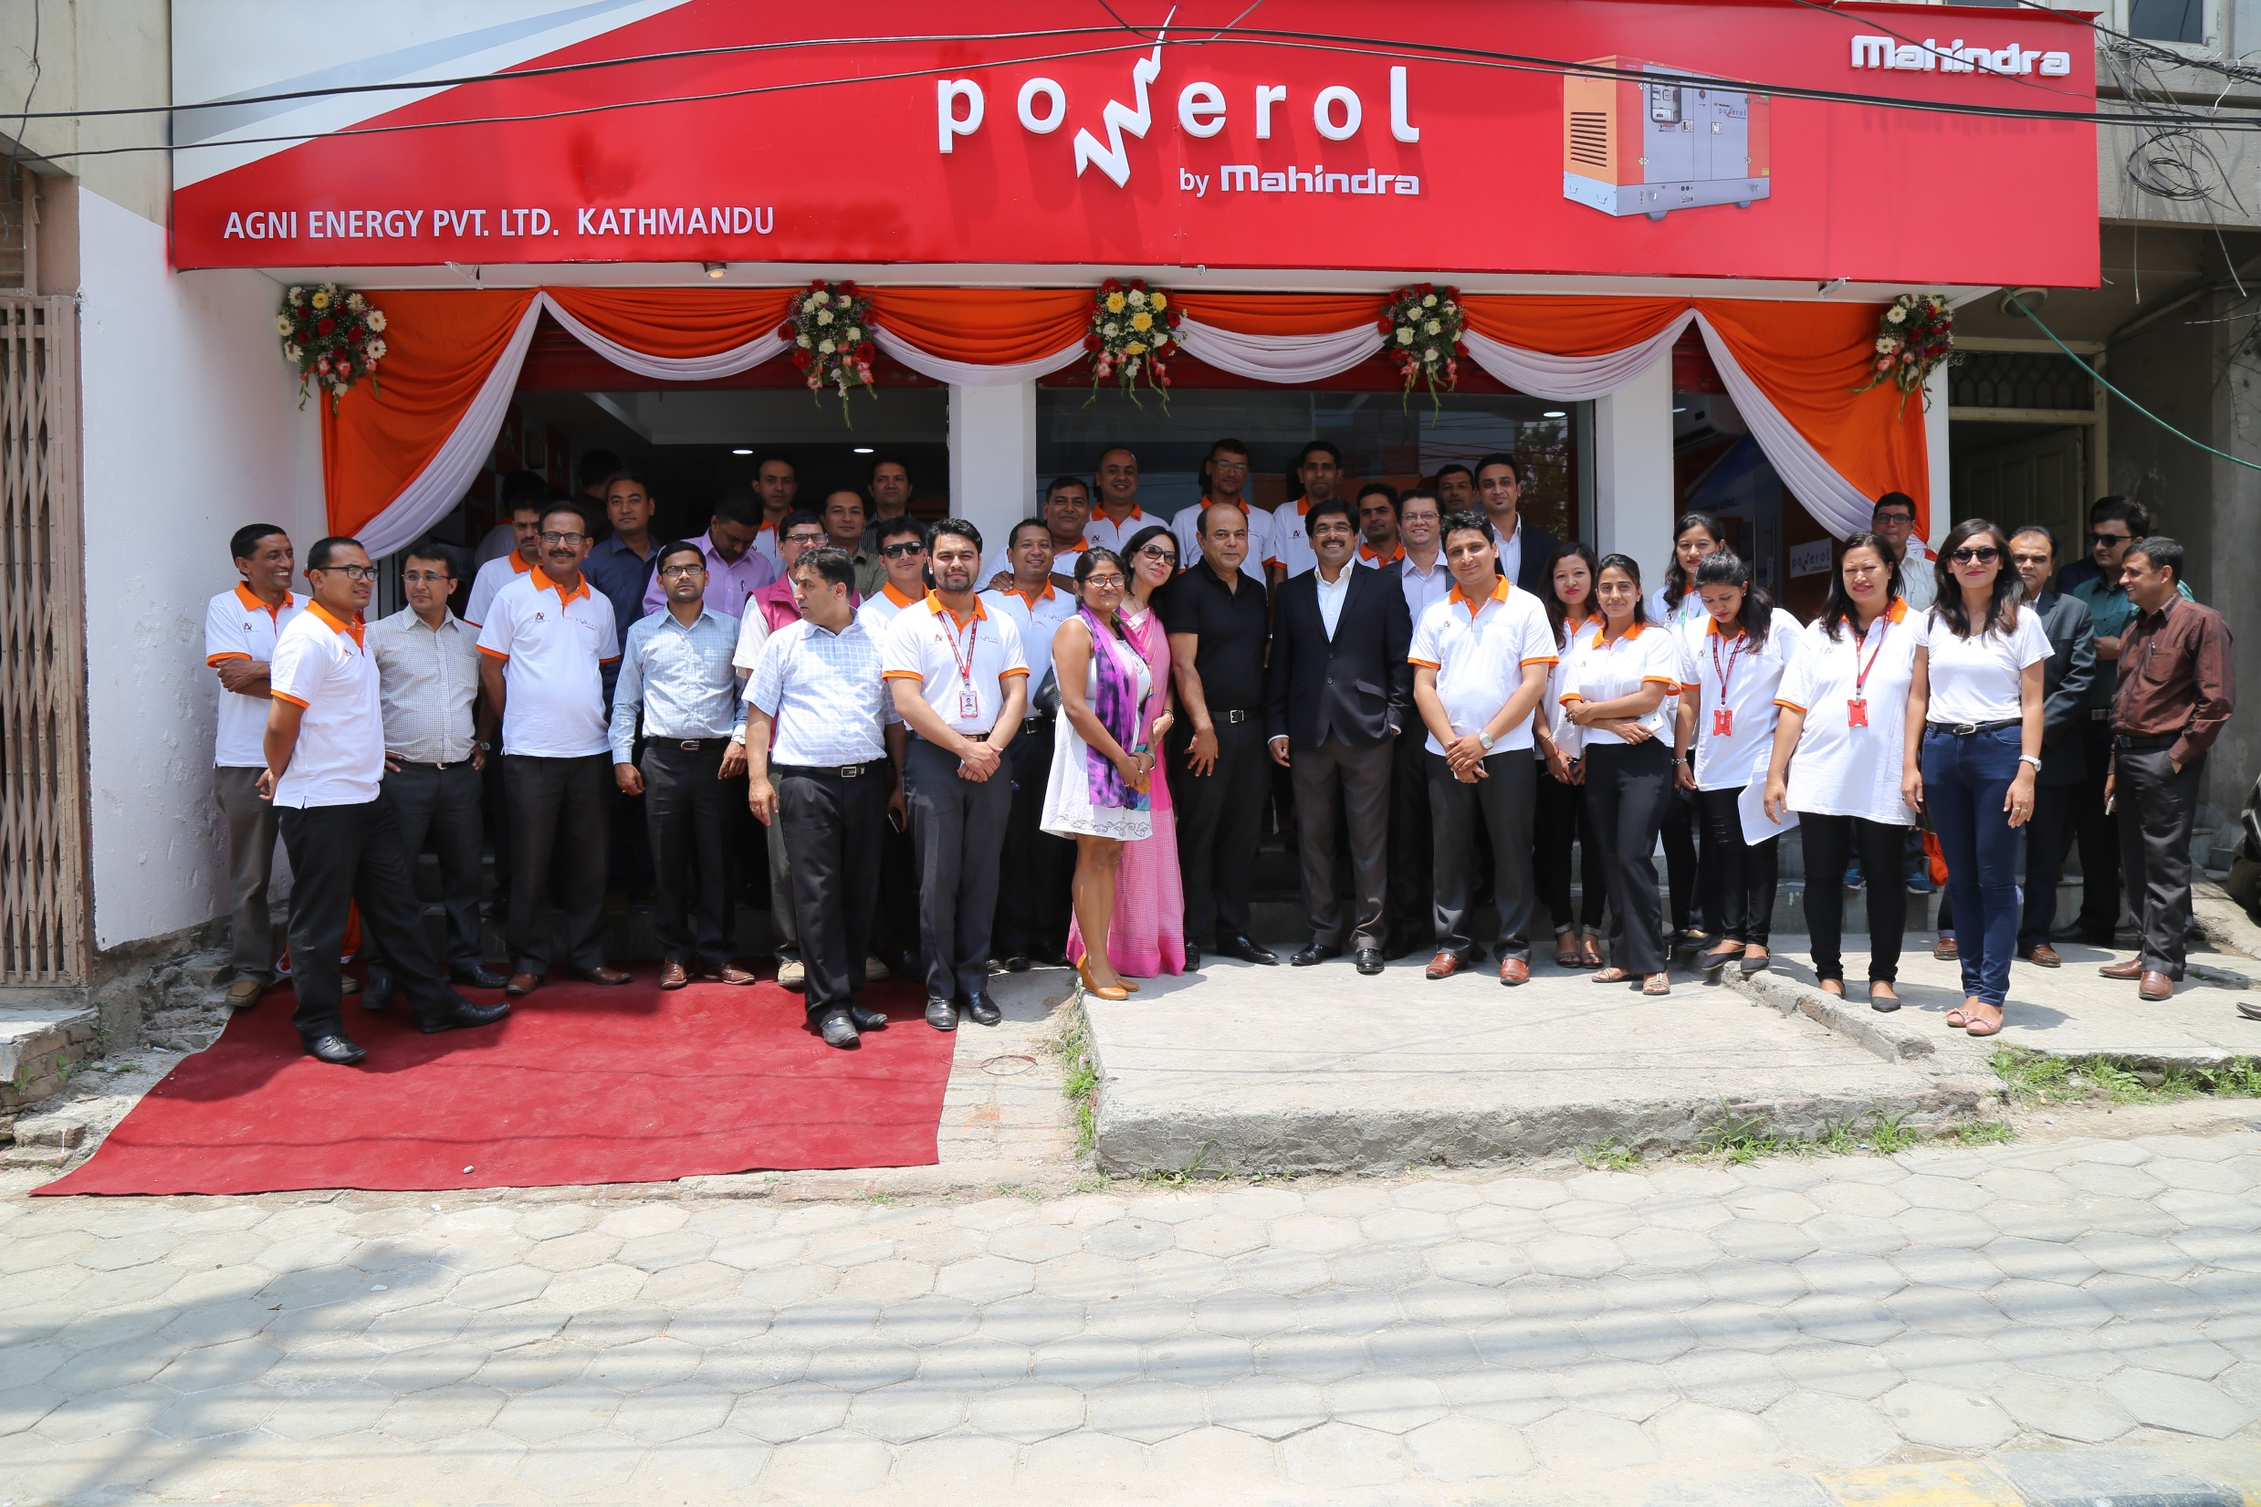
THANK YOU!

Slide 31

Mahindra Group- Corporate AV
Agni Group

Slide 32
Corporate Profile- Agni Group
Present in Automobile Trading Business from last 25 years
Represent among 76 % market share in Utility Vehicle Segment
Wide presence of dealers and distribution channel across the country
Continuous Market Diversification in Energy & Power Backup Solutions
Dedicated marketing, sales and product development team for continuous value addition of products marketed by Agni.

Slide 33
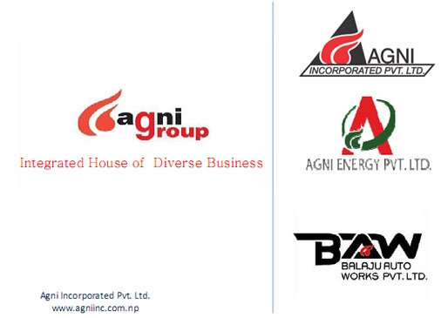
Business Portfolio

Slide 34
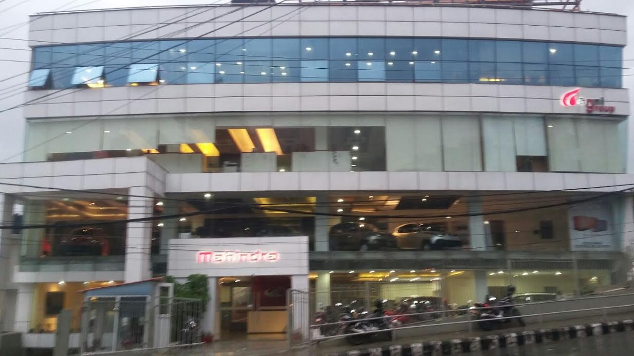


Infrastructure
Corporate Office
Agni MotoInc
Balaju Auto Works

Slide 35

Introduction to Agni Energy Pvt Ltd
Founded in 2012
Head office: Hattisar Kathmandu
Powerol showroom: Gairidhara Kathmandu
Annual turnover: ~NPR 25 Cr
Products: Mahindra E20, Mahindra Powerol, Batteries & Inverters
Manpower: 50+ employees
Dealers: 75+ touch points
Head Office: Hattisar
Powerol Showroom: Gairidhara

Slide 36




Products
Mahindra E20
Mahindra Powerol
Inverters & Batteries

Slide 37

Dealer Network- Agni Energy Pvt Ltd (Powerol)
11 dealers under Agni Energy for Powerol Business

Slide 38
THANK YOU!

